Slide 1

SDN: Emulation, Implementation and Load Balancing

Slide 2
Traditional Network

Slide 3
What’s Networking
A network is a group of two or more computer systems linked together

Slide 4
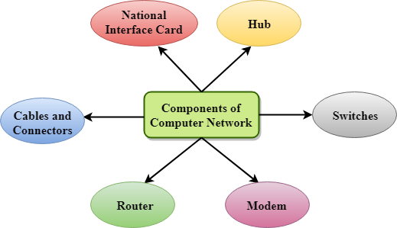
Network components

Slide 5
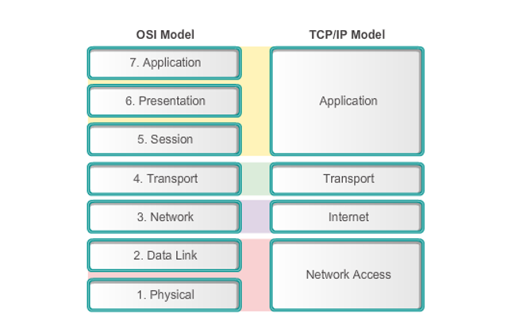
Network Models

Slide 6
Network Types
LAN
WAN
MAN
VPN

Slide 7
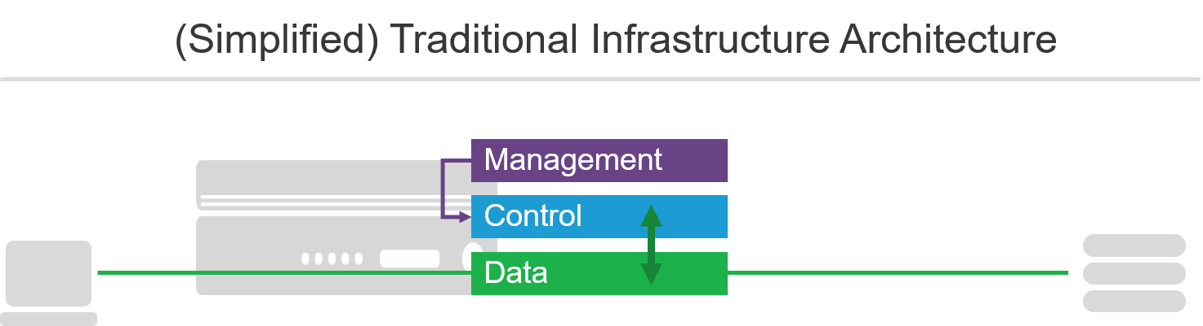
Network Architecture
Device Planes :

Slide 8
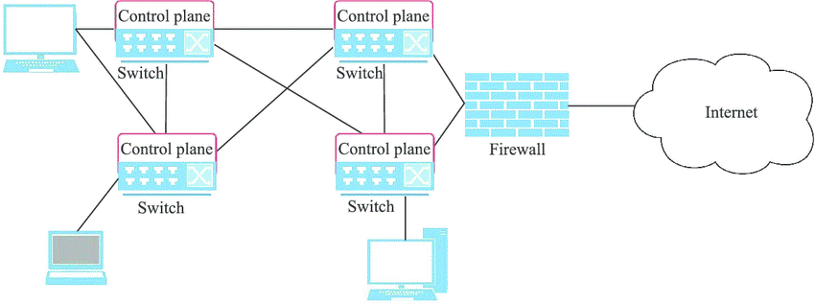
Network Architecture
In the traditional network architecture, control plane and data plane are integrated and any changes to the system are dependent upon physical network devices, the protocols and software they support. Limited changes can be performed to the overall system as the network devices bottleneck logical network traffic flows.

Slide 9
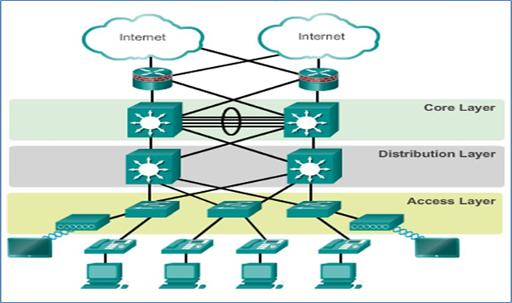
Network Infrastructure
It consists of core layer switches which connect to distribution layer switches (sometimes called aggregation switches), which in turn connect to access layer switches. Access layer switches are frequently located at the top of a rack, so, these are also known as top-of-rack (TOR) switches. Most network infrastructure is still laid out this way today.

Slide 10
Software Defined Network

Slide 11
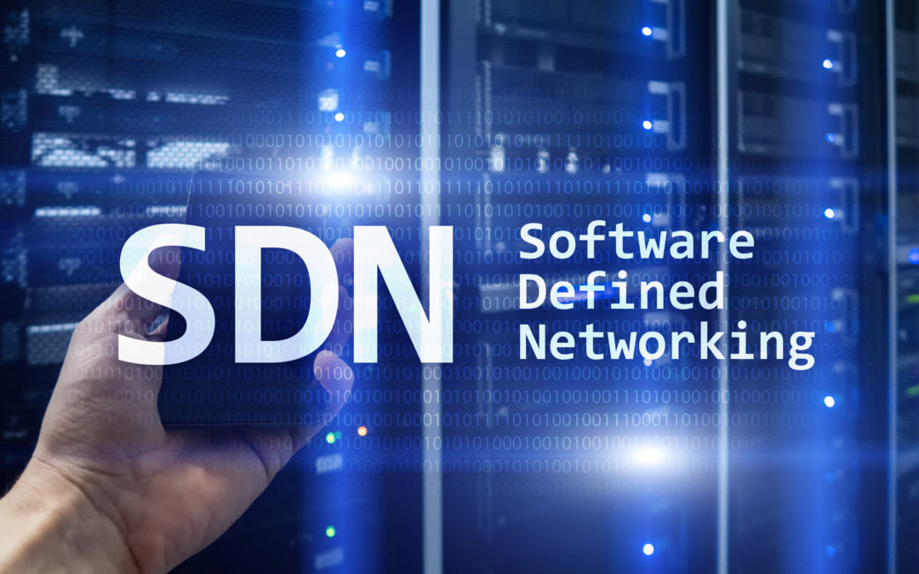
SDN Technology
Software-Defined Networking (SDN) technology is an approach to cloud computing that facilitates network management and enables programmatically efficient network configuration in order to improve network performance and monitoring.

Slide 12
Why We Need SDN?
Visibility
Performance
Multi-tenancy
Service Integration
Virtualization
Orchestration
Programmable
Dynamic Scaling.
Automation

Slide 13
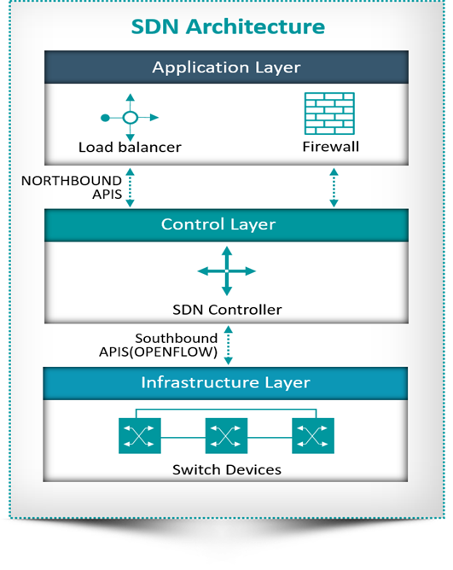
SDN Architecture
SDN broadly consists of three layers:
Application layer
Control layer
Infrastructure layer

Slide 14
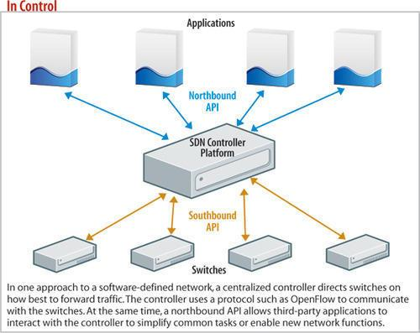
Control Layer
Northbound interface: is meant for communication with upper, Application layer and would be in general realized through REST APIs of SDN controllers.
Southbound interface: is meant for communication with lower, Infrastructure layer of network elements and would be in general realized through southbound protocols OpenFlow, Netconf, Ovsdb, etc.
The east-west interfaces: which are not yet standardized, allow communication between the multiple controllers. They use a system of notification and messaging or a distributed routing protocol like BGP and OSPF.

Slide 15
Software Defined Network
Advantage
Disadvantage
Directly programmable
Agile
Centrally controlled:
Open standards-based
Network management Simplicity
Fast service deployment
Automated configuration
Saving cost, effort and time
CAPEX reduction
It requires change in entire network infrastructure to implement SDN protocol and SDN controller.
Staff need to be trained.
Single point of failure.
Security is a big challenge in SDN.
New management tools need to be procured and everyone should be trained to use it.

Slide 16
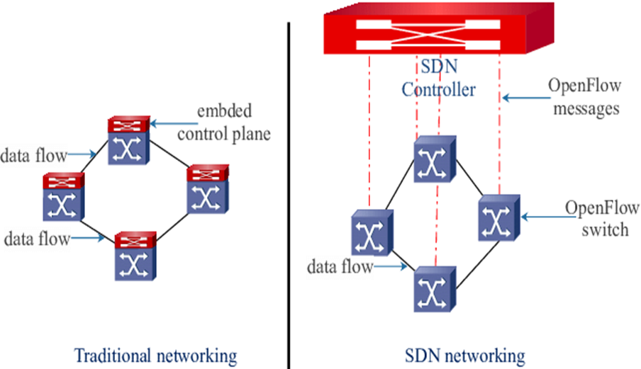
Traditional Network VS. SDN
There are three most important differences between traditional networking and SDN.
First, the SDN controller has a northbound interface that communicates with applications via application programming interfaces (APIs).
Second, SDN is a software-based network, which allows users to control virtual-level resource allocation through the control plane and to determine network paths and proactively configure network services.
Third, SDN has more ability to communicate with devices throughout the network than traditional networking.

Slide 17
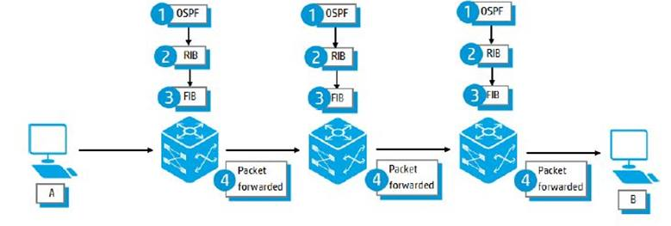
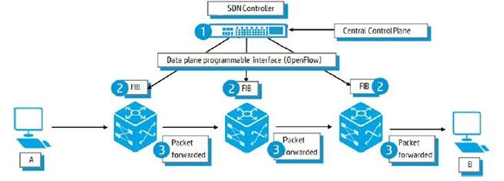
Traditional Network VS. SDN Cont.
Traditional Network
SDN
Traditional Network - Configuration complexity increases the need for synchronization which limits performance of devices.
SDN network, modular control and central view of network components.

Slide 18
Traditional Network VS. SDN Cont.
Component | Cost
Switch 2960 | 4000$*4=16000 USD
Switch 3560 | 9000$* 2 = 18000 USD
Router 2911 | 9000$
RAC and Power Distribution and cables | 2000$
PC For each employee | 500 USD * 50 = 25000 USD
Component | Cost
SDN controller | 4000$
Open virtual switch | 2000$*6=12000$
PC For each employee | 500 USD * 50 = 25000 USD
Total cost = AROUND 80,000 USD
Total cost = AROUND 41,000 USD

Slide 19
OPENFLOW Protocol

Slide 20
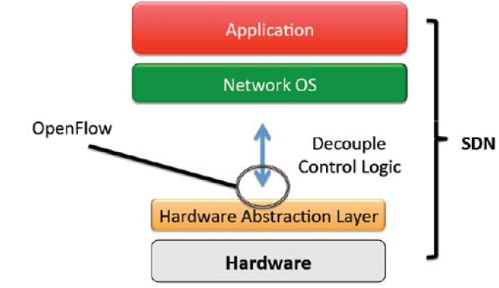
OPENFLOW Protocol
OpenFlow is an open standard protocol specifically designed for the SDN networks that allows the communication between the control and data planes.

Slide 21
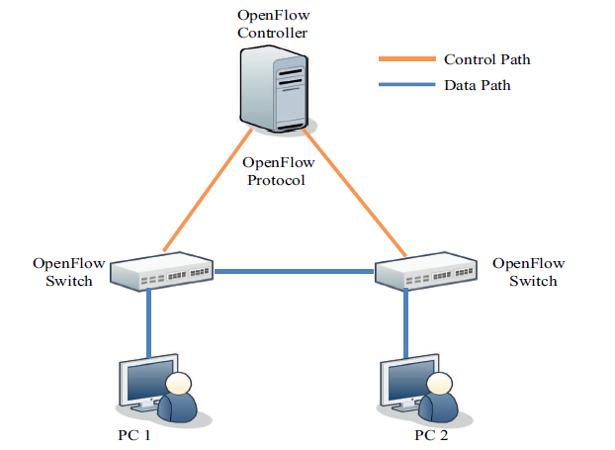
OpenFlow Architecture
OpenFlow switches that compose the data plane.
The control plane consists of one or more OpenFlow controllers.
A secure control channel connects the switches with the control plane.

Slide 22
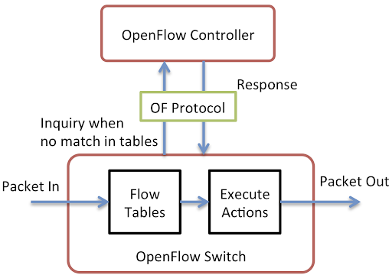
Open flow switch
The OpenFlow-enabled switch is the basic forwarding device that forwards the packets according to its flow table which is similar to traditional forwarding tables but not managed and maintained by the switch.

Slide 23
OpenFlow Switch Ports
Physical ports
Logical ports
Reserved ports:-
All
Table
Controller
In port
Any
NORMAL
OpenFlow ports are the network interfaces for passing packets between OpenFlow processing and the rest of the network.

Slide 24
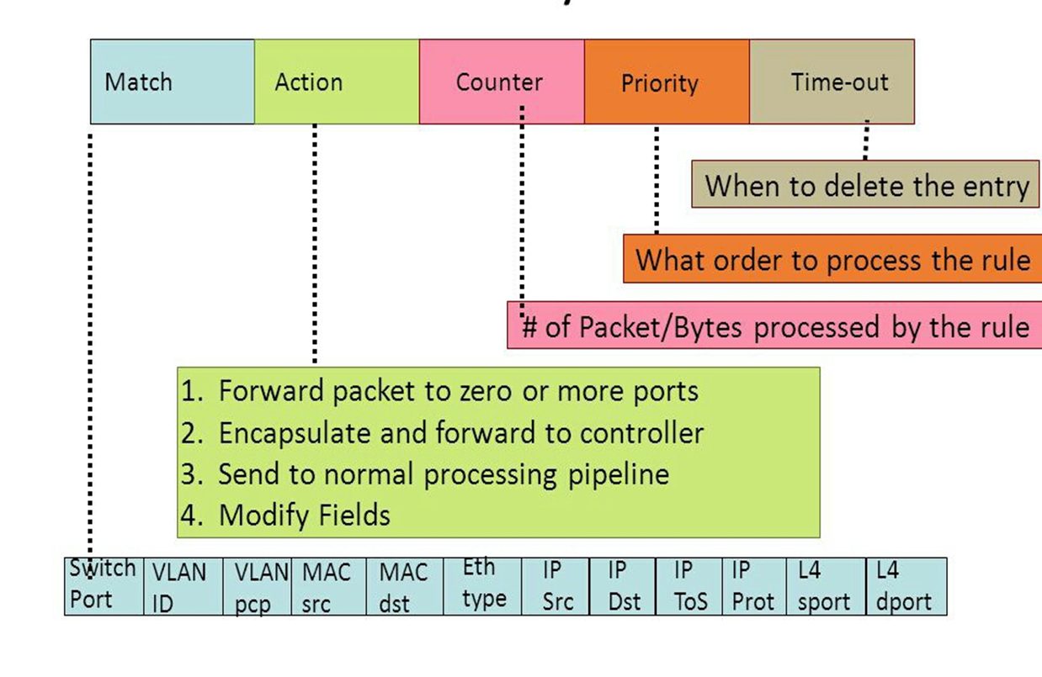
OpenFlow Table Entry

Slide 25
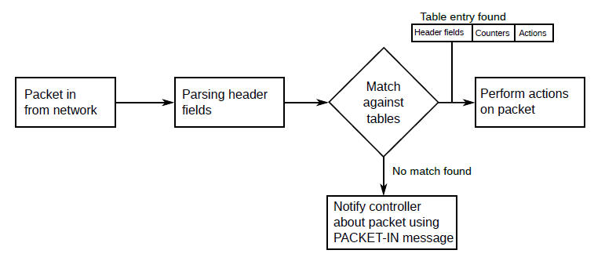
Packet Process Mechanism for OpenFlow Switch

Slide 26
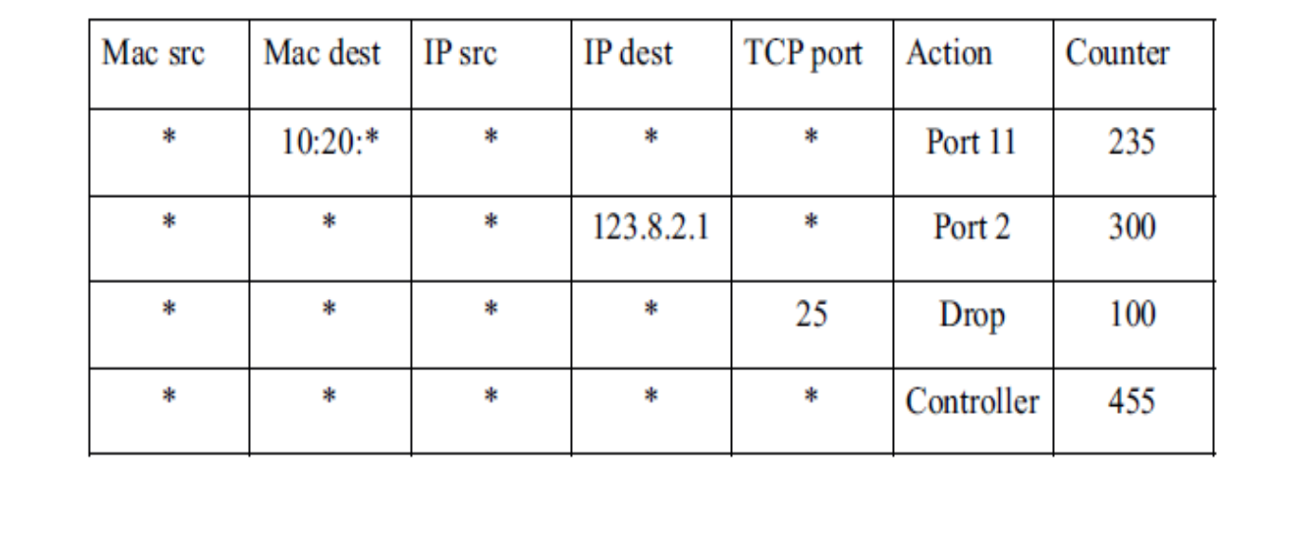
OpenFlow Switch Actions
Forward
ALL
CONTROLLER
Drop

Slide 27
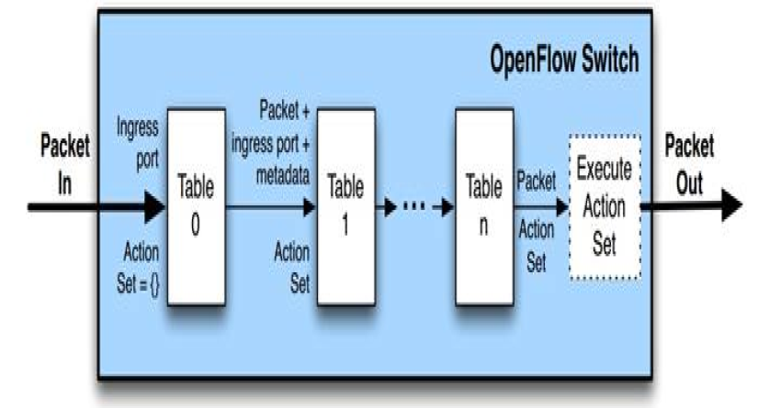
Pipeline Processing
OpenFlow-compliant switches come in two types:
OpenFlow only
OpenFlow hybrid

Slide 28
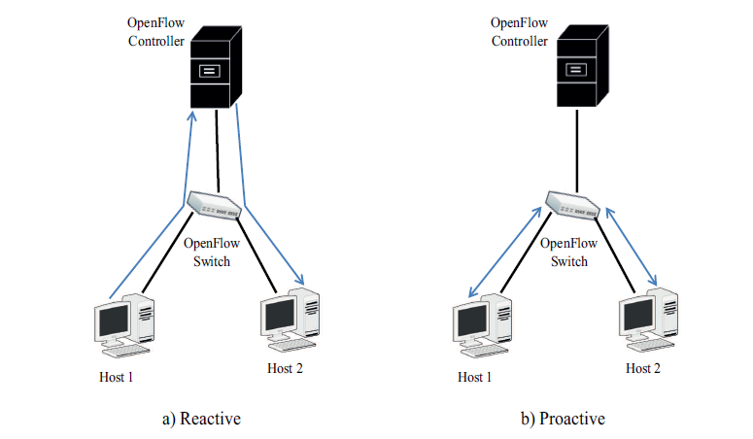
Flow types
Flows populated from the OpenFlow controller can be classified into types:
Reactive
Proactive

Slide 29
OpenFlow Communication Messages
Hello
Echo
Controller-to-switch
Asynchronous Messages
Symmetric
Modify-State
Read-State
Features
Send-Packet
Packet-in
Port-status
Error
Flow-Removed

Slide 30
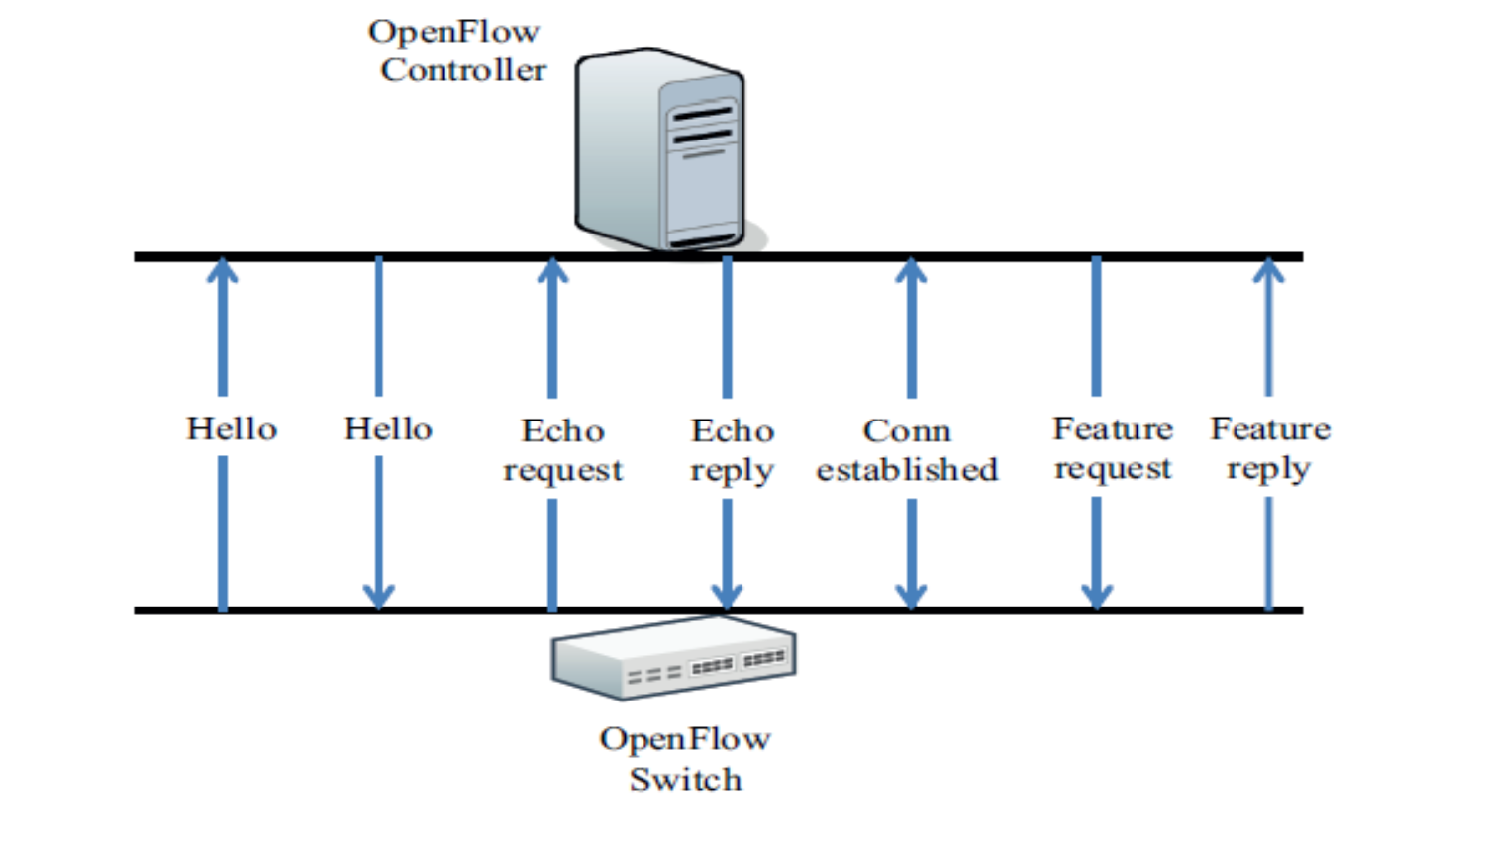
OpenFlow Communication Messages Cont.
Message establishment between a switch and a controller

Slide 31
OpenFlow Communication Messages Cont.
Messages exchanged between two hosts.

Slide 32
Mininet

Slide 33
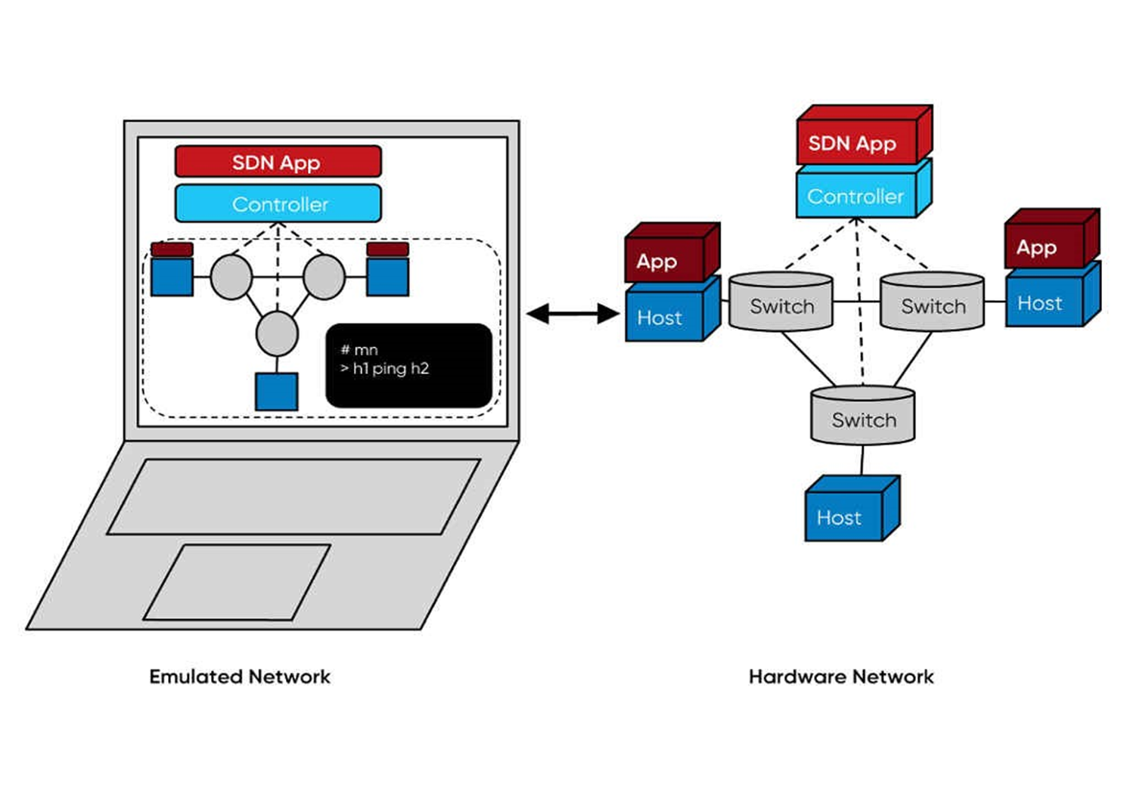
What’s Mininet?
A network emulator which creates realistic virtual network.
It runs a collection of end-hosts, switches, routers, and links on a single Linux kernel.
Provides both Command Line Interface (CLI) and Application Programming Interface (API)
CLI: interactive commanding
API: automation
The code used in Mininet can be used with no or minimal changes on real SDN OpenFlow networks.
A design that works in Mininet can usually move directly to hardware switches.

Slide 34
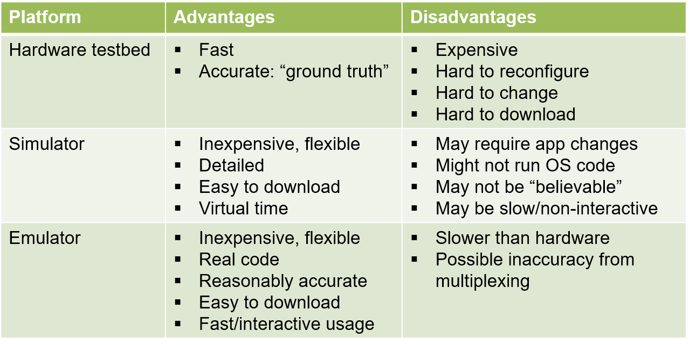
Why Mininet?

Slide 35
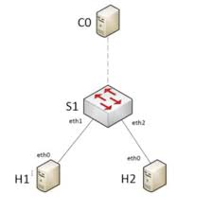
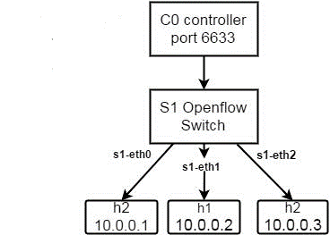
Mininet command line Interface usage
Mininet default topologies
Mininet Custom Topologies
$ sudo mn
$sudo mn --topo=single,3 --mac --controller=remote switch=ovsk,Protocols=OpenFlow1

Slide 36
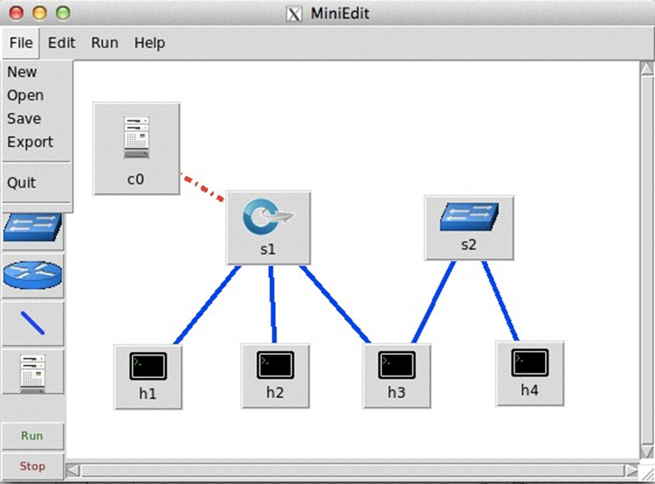
MiniEdit
Create your network topology.
Save: for MiniEdit data file.
File >> save
Export: for Mininet script file.
File >> export
To run the exported script:
% sudo SAVE_FILE_NAME.py
Run Mininet from MiniEdit.
Run >> Run

Slide 37
SDN Controllers

Slide 38
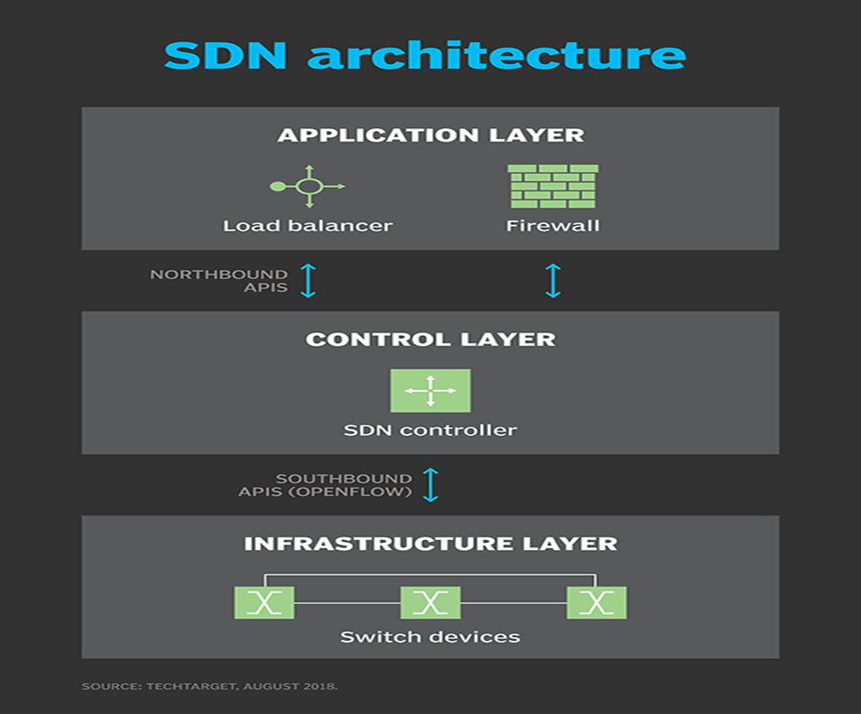
The General description of a SDN Controller
An SDN controller is an application in a software-defined networking (SDN) architecture that manages flow control for improved network management and application performance.
The controller is the core of a software-defined network. It resides between network devices at one end of the network and applications at the other end. Any communication between applications and network devices must go through the controller.

Slide 39
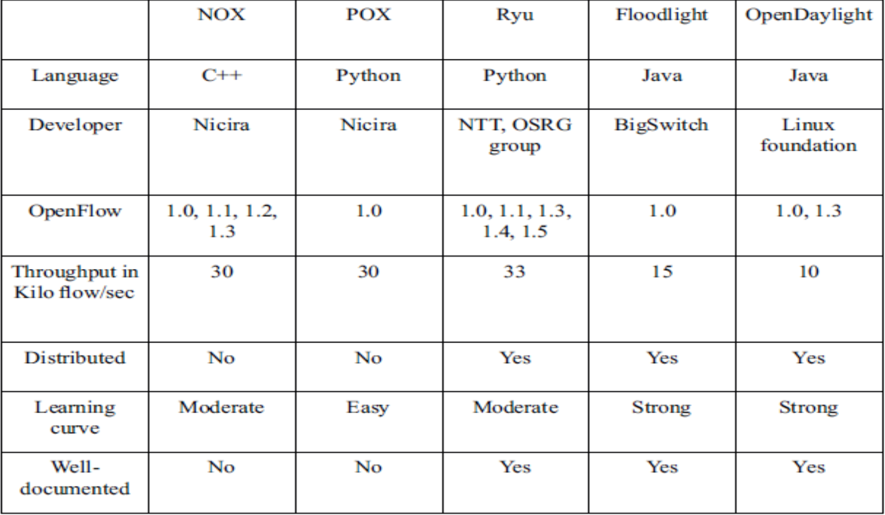
List of SDN Controllers
Open-Source Controllers
Commercial Controllers
Active Resource Controller
Calsoft Labs Virtual WLAN Controller
Cisco Application Policy Infrastructure Controller (APIC)
Cisco Application Policy Infrastructure Controller (APIC) Enterprise Module
CPLANE NETWORKS Controller
Embedded Systems Software Development in Networking
Extreme Networks Slalom
HP Virtual Application Networks (VAN) SDN Controller
IBM Programmable Network Controller
Inocybe Infrastructure Controller
Italtel Session Border Controller

Slide 40
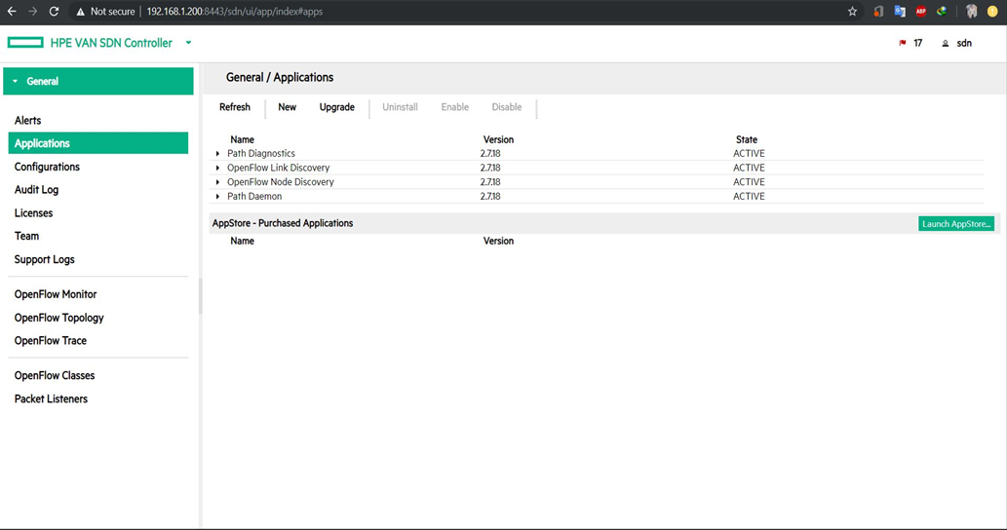
HPE VAN
provides a unified control point in an OpenFlow-enabled network, simplifying management, provisioning, and orchestration and enabling delivery of a new generation of application-based network services.
List of controller embedded applications:
• OpenFlow Link Discovery
• OpenFlow Node Discovery
• Path Diagnostics
• Topology Manager
• Topology Viewer

Slide 41
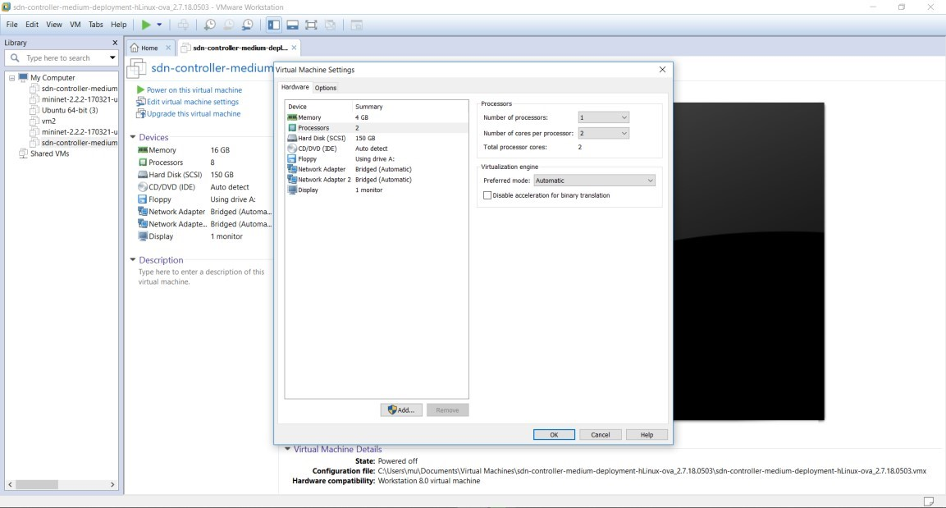
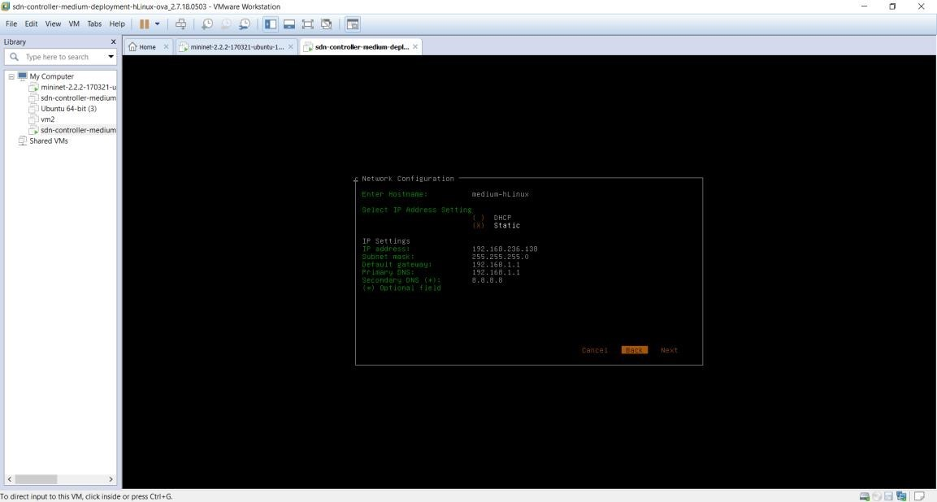
Running HPE VAN
Step 1 : Import virtual Machine
Step 2 : Assign Static ip

Slide 42
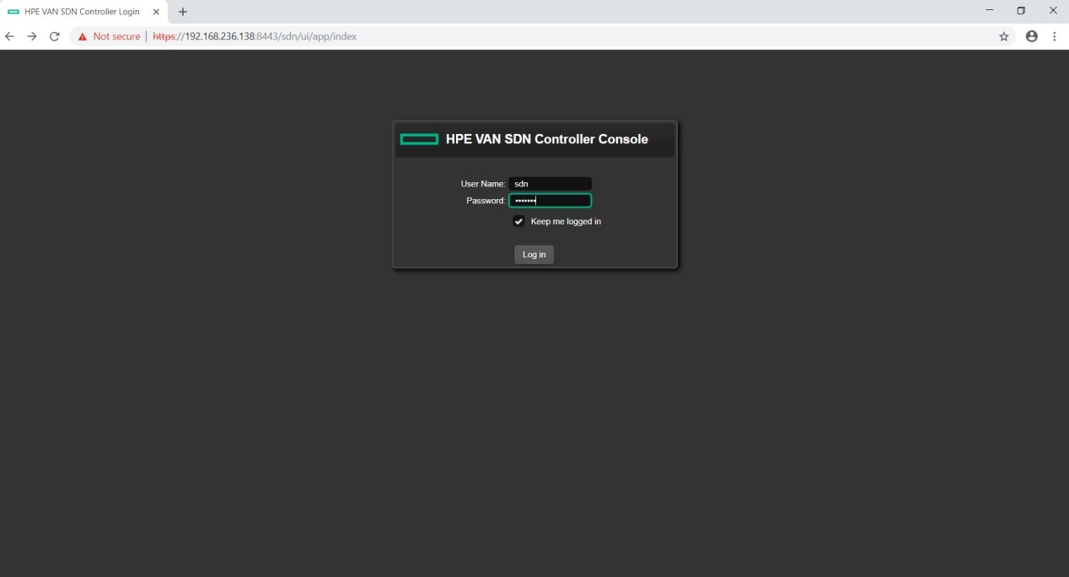
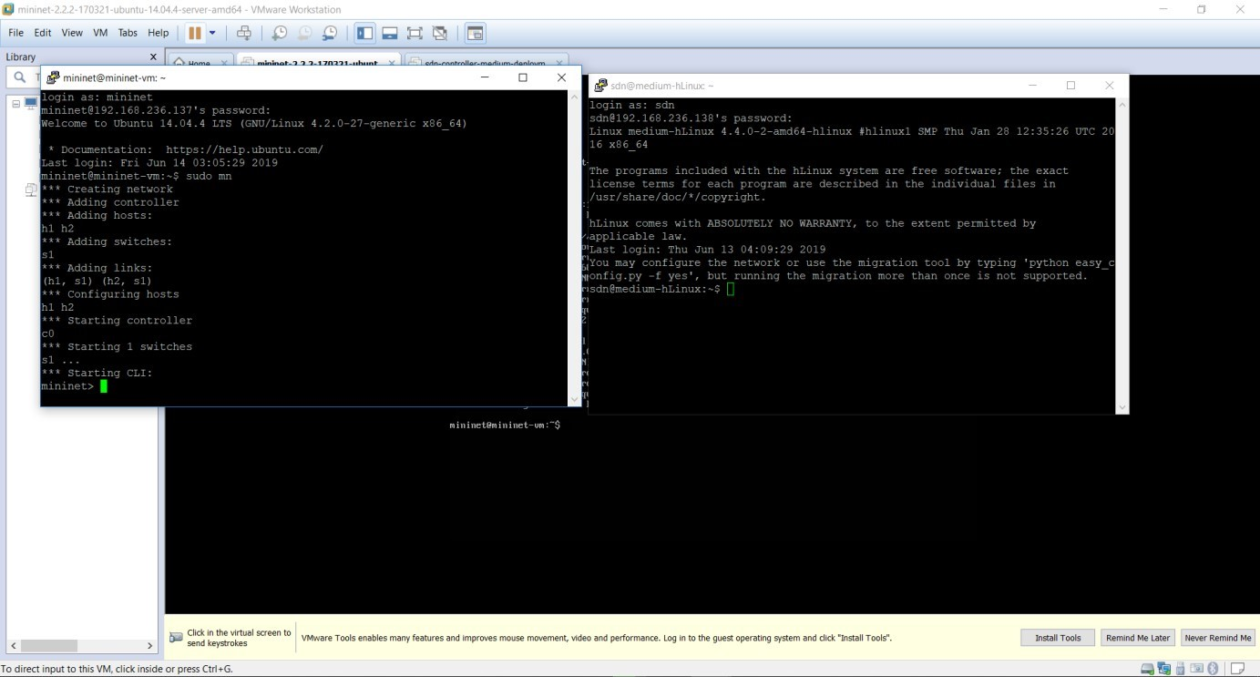
Running HPE VAN
Step 3: Create Simple topology and Define Controller Machine
Step 4: Connect to HPE VAN GUI
$ sudo mn -- controller=remote,ip=192.168.236.138

Slide 43
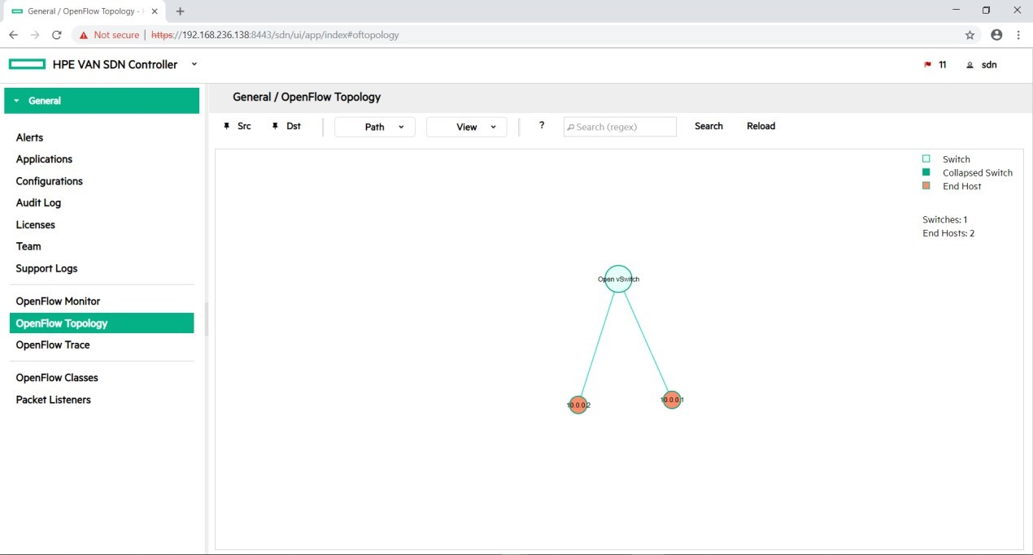
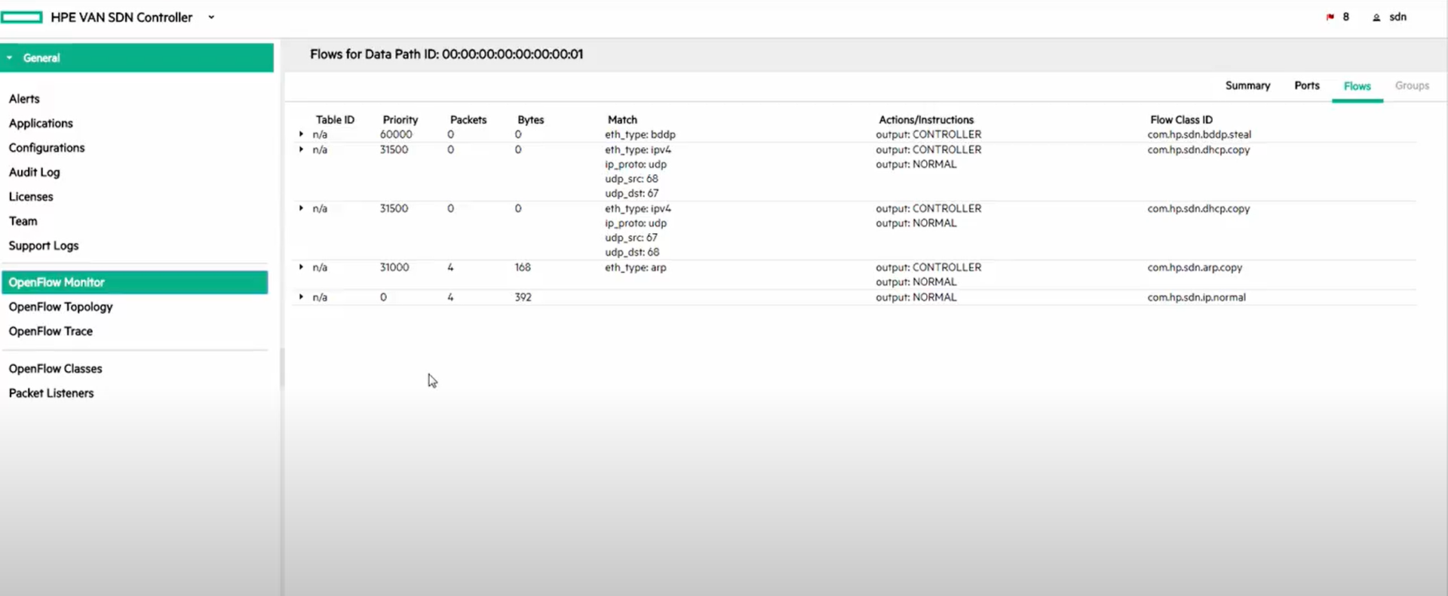
Running HPE VAN
Step 5: Sudo mn Output
Step 6: Flow Table

Slide 44

RYU
Ryu Controller is an open, software-defined networking (SDN) Controller designed to increase the flexibility of the network by making it easy to manage and adapt how traffic is handled.

Slide 45
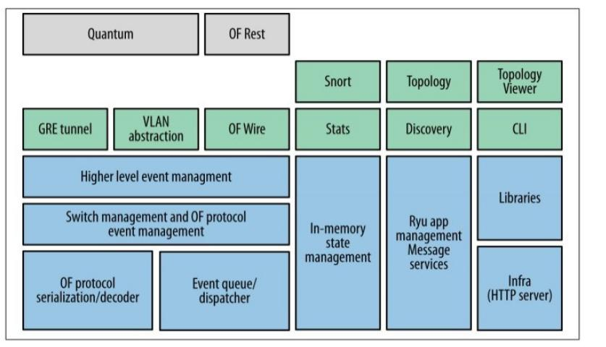
RYU Architecture

Slide 46
Ryu Applications
Simple Switch
STP
Simple Monitor
Rest Router

Slide 47
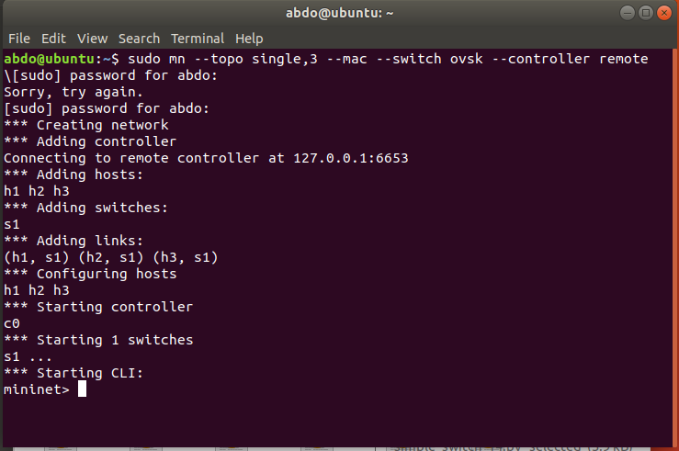
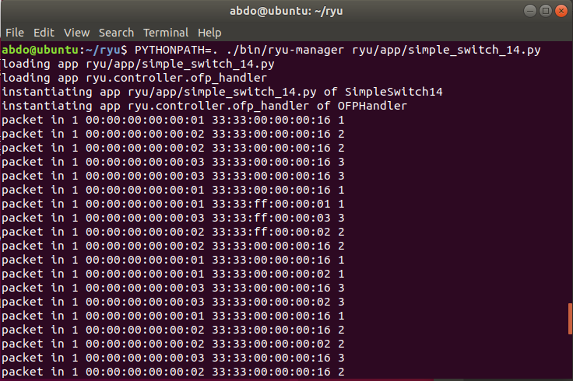
Simple L2 Switch Application
Topology
Results

Slide 48
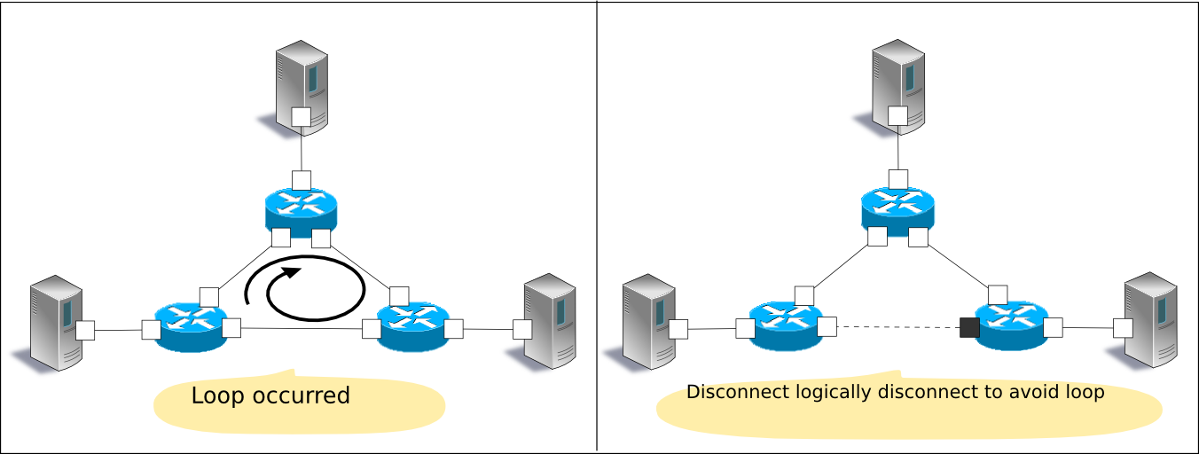
STP Application
Spanning tree is a function that suppresses occurrence of broadcast streams in a network having a loop structure. Also, applying the original function that is preventing the loop, it is used as a means to secure network redundancy to automatically switch the path in case of a network failure.

Slide 49
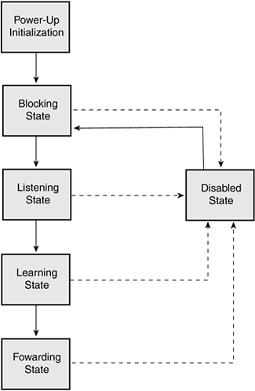
STP Overview
Selecting the root bridge:
Root port
Designated ports
Non designated ports

Slide 50
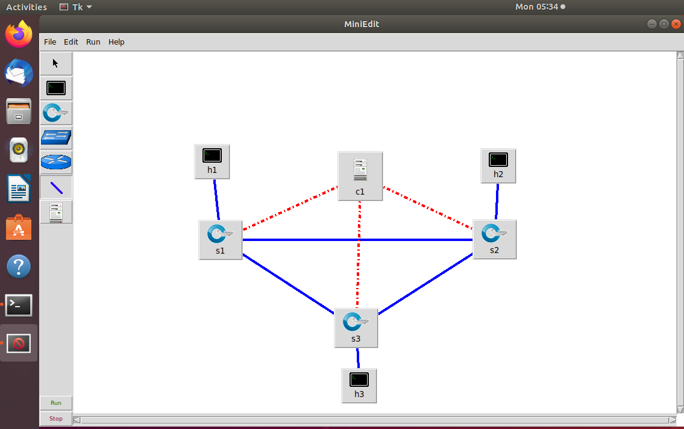
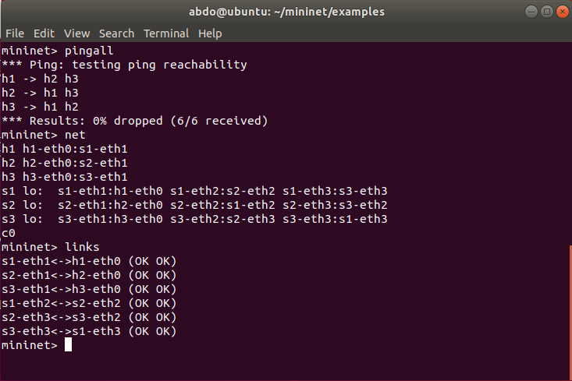
STP Application
Topology Using MiniEdit
Topology Commands

Slide 51
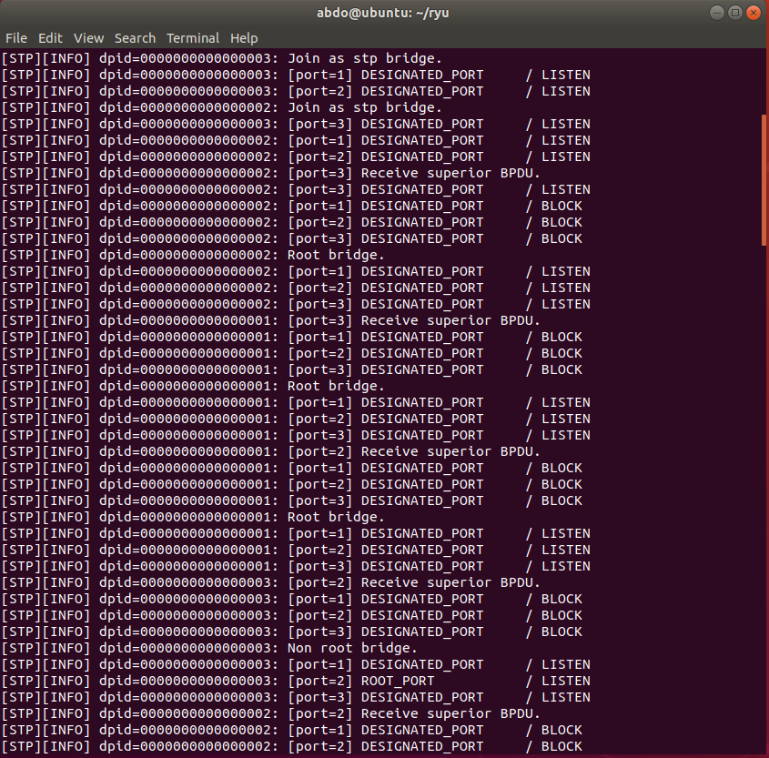
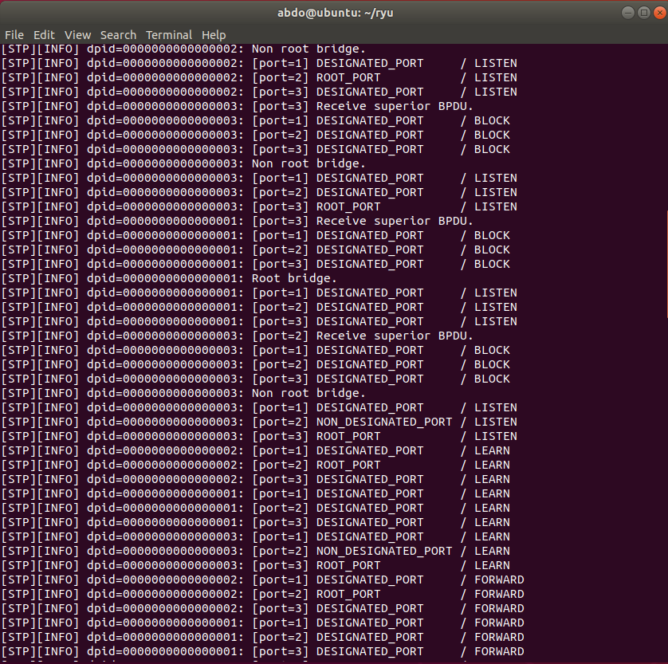
STP Application
BPDU Exchange
Packets Flow

Slide 52
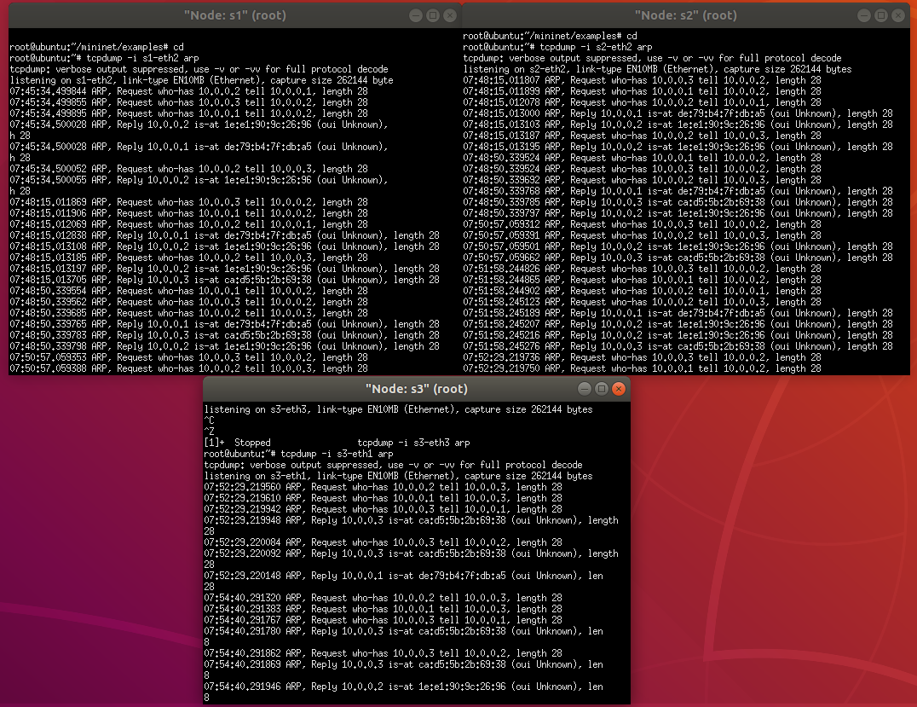
STP Application
As a result of tcpdump
output, you can confirm
that ARP is not looped

Slide 53
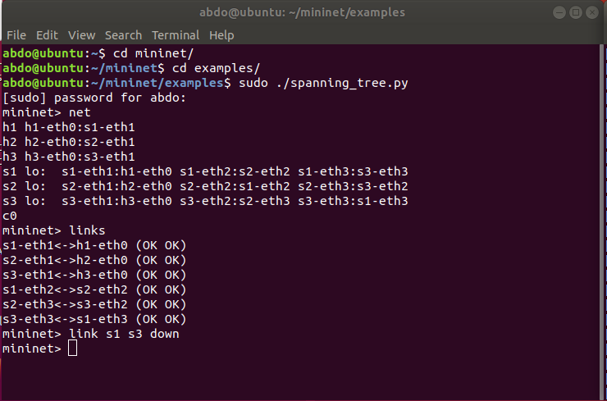
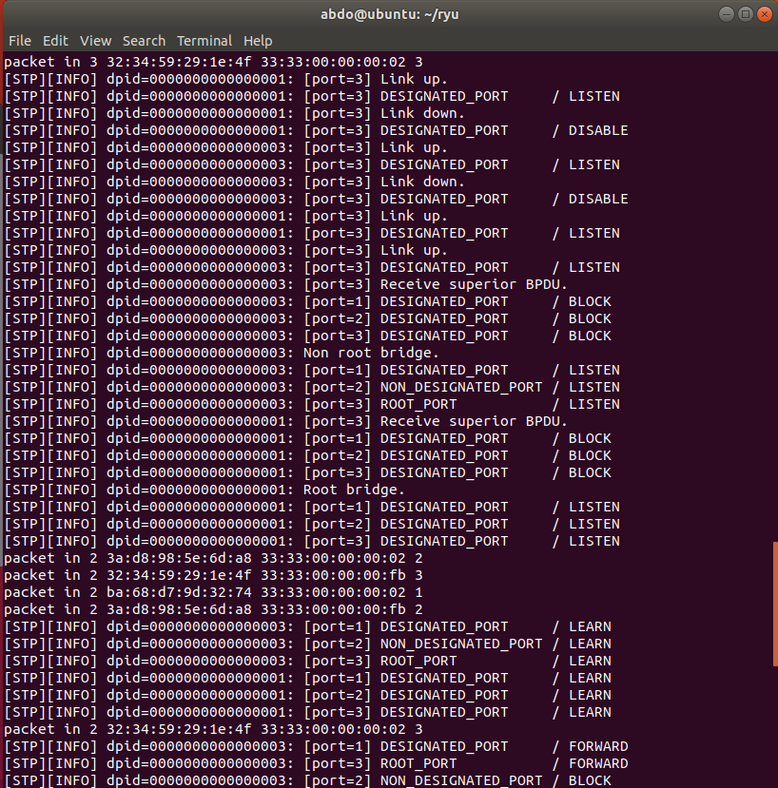
STP Application
Try Link S1 – S3 Down
Detect Failure , Recalculate

Slide 54

Pox
POX is an open source development platform for Python-based software-deﬁned networking (SDN) control applications, such as OpenFlow SDN controllers.
It is a popular tool for teaching about and researching software deﬁned networks and network applications programming
POX Features
Pythonic OpenFlow interface.
Reusable sample components for path selection, topology discovery, etc.
Speciﬁcally targets Linux, Mac OS, and Windows.

Slide 55
POX Components
forwarding.hub: The hub example just installs wildcarded flood rules on every switch
forwarding.l2_learning: This component makes OpenFlow switches act as a type of L2 learning switch
forwarding.l3_learning:
./pox.py forwarding.l3_learning --fakeways=10.0.0.1,192.168.0.1

Slide 56
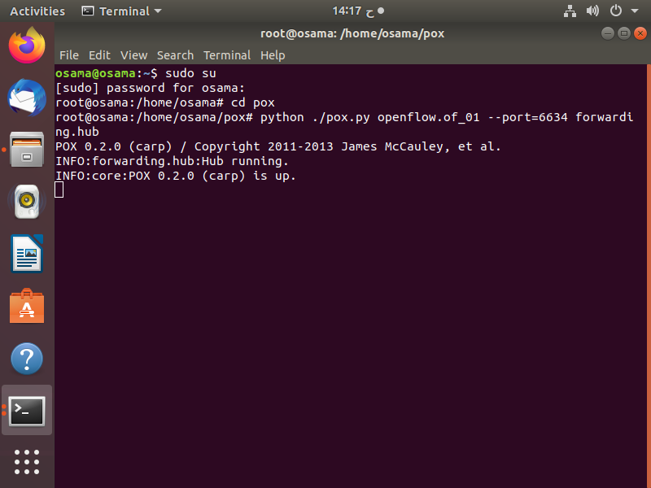
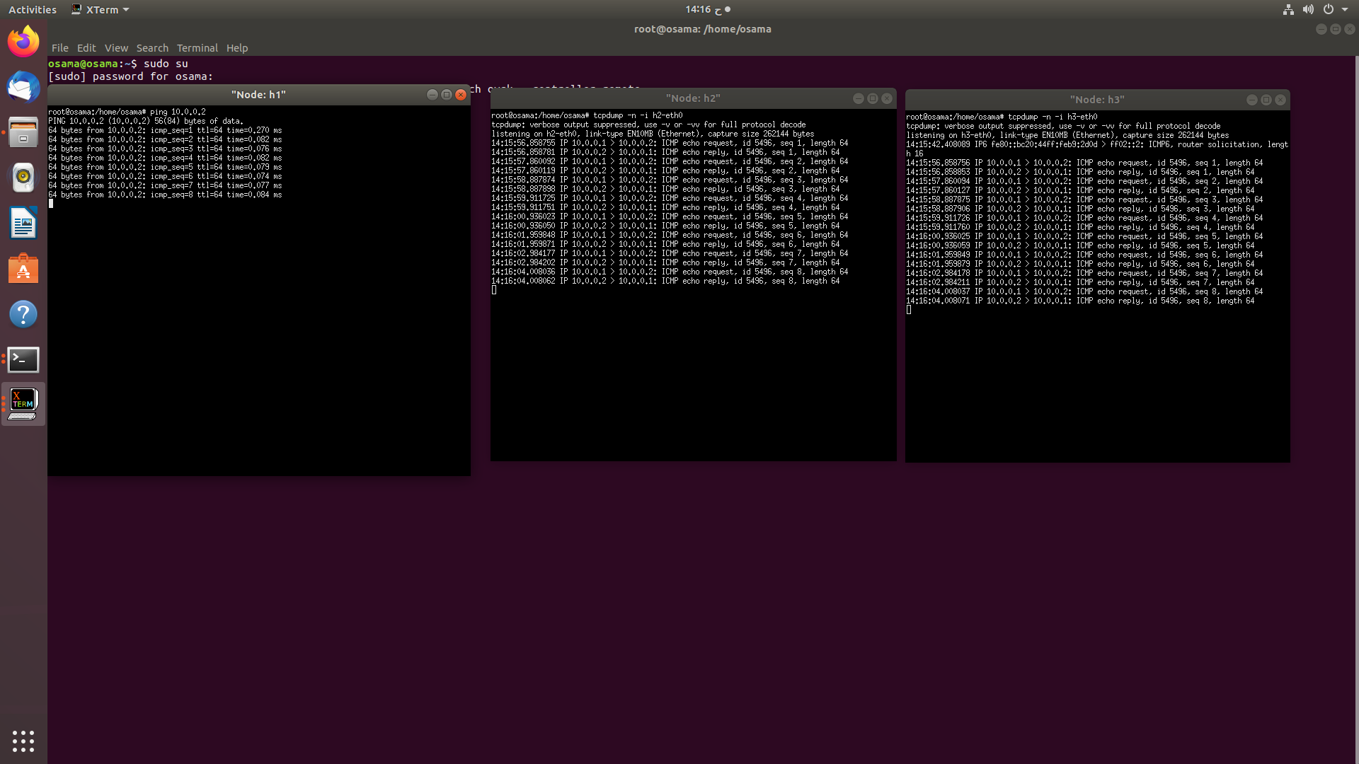
Forwarding.hub
Running Controller
Checking traffic

Slide 57
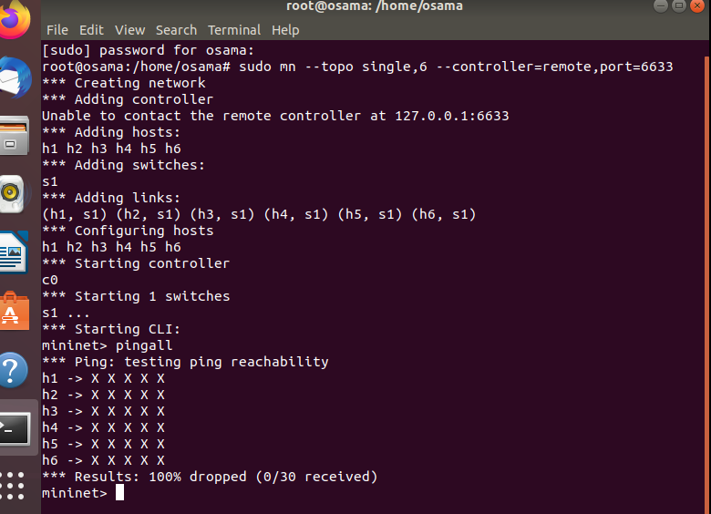
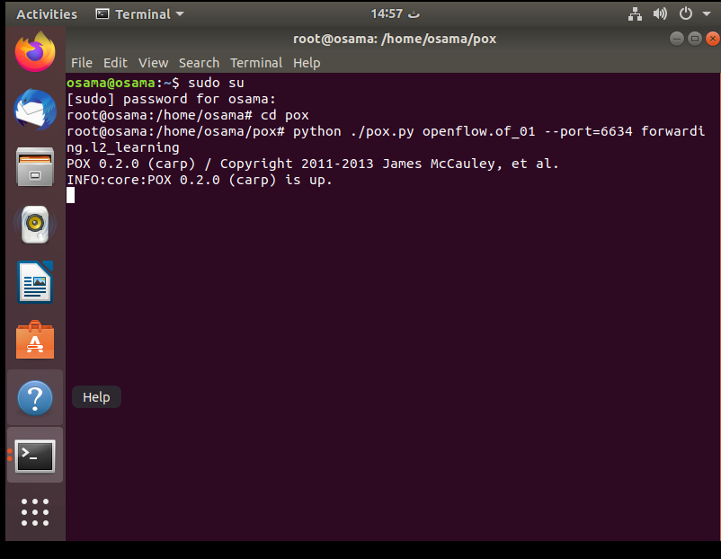
forwarding.l2_learning
Problem
Running Controller

Slide 58

forwarding. l2_learning
This component makes OpenFlow switches act as a type of L2 learning switch

Slide 59


Making Custom Topology

Slide 60


Load Balancing, How The System works ?

Slide 61
Load balancing algorithms
Random-based: The controller selects one server randomly from the available servers for each request.
Round-robin: This technique distributes the requests among the servers in a sequential manner.
Connections-based: This algorithm chooses the server based on minimum active connections.

Slide 62


Load Balancing Algorithms
Step 1
Step 2

Slide 63


Load Balancing Algorithms
Step 3
Step 4

Slide 64

Round Robin
Weighted round robin:
It can be used effectively for a cluster of unidentical servers as each server is assigned a weight based on its structure and efficiency.
Dynamic round robin:
It forwards the requests to the associated server based on a real-time calculation of server weights.

Slide 65
Other Algorithms
Bandwidth-based (BWBLB)
Server CPU-based (CBLB)
Server CPU-Memory-based (CMBLB)
The least response time
URL hash
Source IP hashThe
The least bandwidth and the
least packets method
The custom load method

Slide 66


Round Robin Applied
Process
Result

Slide 67
Round Robin and Random

Slide 68
Tools

Slide 69
Openload
Definition
Options
-t
-h
-l
OpenWebLoad is a tool for load testing web applications. It aims to be easy to use and providing near real-time performance measurements of the application under test.
openload [options] url [clients]

Slide 70

Openload
Results:
Parameters:
$ openload localhost 10
MaTps
Tps
Total TPS is the average TPS for the whole run, i.e. (Total completed requests) / (Total elapsed time).
Avg. Response time
Max Response time

Slide 71
SIEGE
Definition
Options
C
c
t
d
b
H
Siege is a Hypertext Transfer Protocol (HTTP) and HTTPS load testing and web server benchmarking utility developed by Jeffrey Fulmer.
$ siege -f /usr/local/etc/urls.txt

Slide 72

SIEGE
Output By Domain
$ siege domain.name

Slide 73
Httpref
Definition
Steps
httperf --server wailua --port 6800
Httpref is a tool for measuring web server performance. It provides a flexible facility for generating various HTTP workloads and for measuring server performance.
httperf --server wailua--port 6800
--num-conns100 --rate10--timeout 1
appropriate timeout values
Total Results
Connection Results
Request Results
Reply Results
Miscellaneous Results

Slide 74

Httpref
Output
Error
total
socket-timo
Connrefused
Connreset
Other

